Slide 1

Predicting Insurance Cross-Sell
OPIM 5512 - Data Science Using Python
Team 2 - Divya Sai Teja Pamarthi, Kirk Becker, Pallavi Moturi, Sai Shashank Reddy Malreddy

Slide 2
01
Agenda

Slide 3
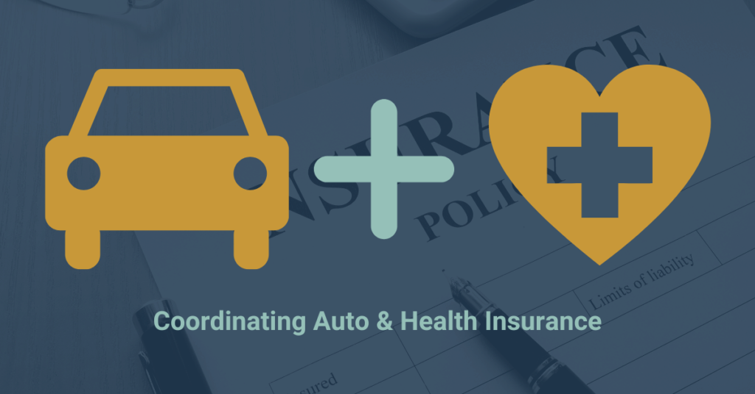
01
Agenda
Introduction
Research
Exploratory Data Analysis
Data Description
Data Pre-Processing
Modeling
Findings
Recommendations

Slide 4
02
Introduction

Slide 5

02
Introduction
ABC Insurance wants to expand its business by providing Auto insurance to its current customer base
ABC Insurance is a newly formed company with 3 years of market experience and a focus on growth. They currently only sell one product, employer sponsored health insurance

Slide 6
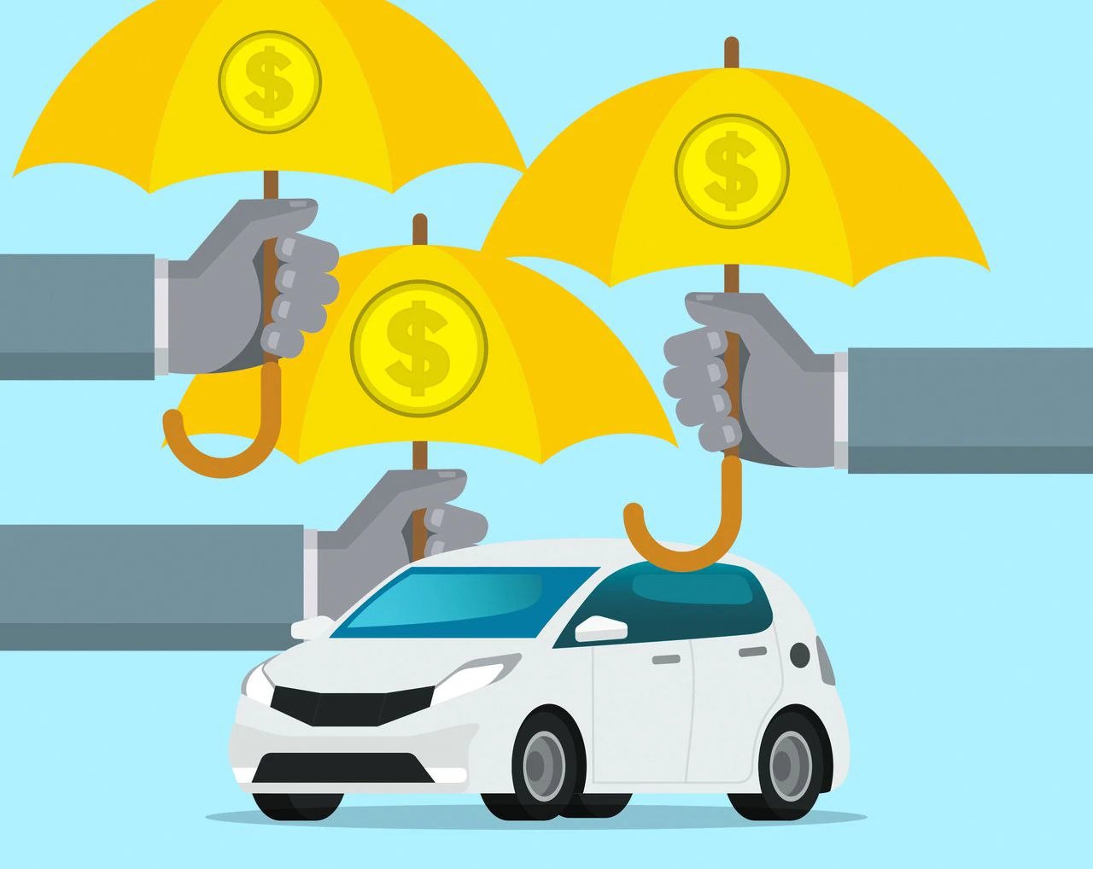



02
Problem Statement
To build a model that predicts whether a Health Insurance customer will purchase Auto Insurance from ABC Insurance.
It would be beneficial for the company to plan its communication strategy accordingly to reach out to those customers and optimize its business model and revenue.

Slide 7
03
Research

Slide 8
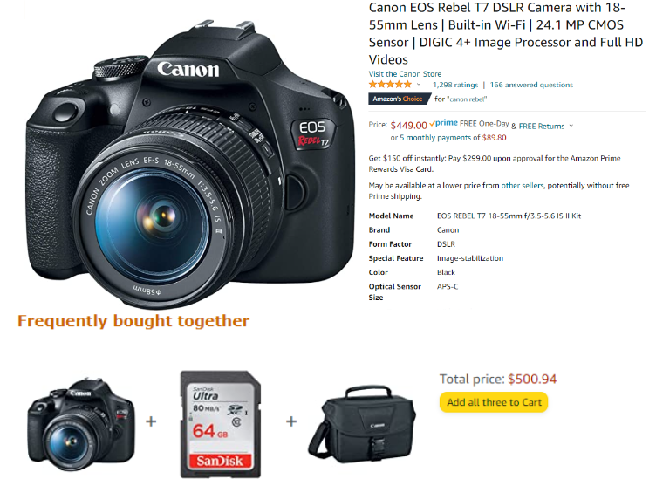
03
Research on Cross-Selling
Cross-selling is a powerful technique used across many industries
Companies have the chance to earn more revenue by offering complementary products to existing customers
Consider how Amazon uses models for their recommender system - this is an example of cross-selling

Slide 9

03
Kaggle Code
What was done earlier?
None of the variables were modified before used for modeling
Inter Quartile Range was used to detect outliers and remove them
Oversampling and undersampling approach
ROC curves are used to describe business insights
What have we done ?
We have built our models using binned variables namely Region_28, Age_Cat, PSC, Vehicle_Age_2
We used IQR for outliers removal
We used oversampling and undersampling techniques to balance the data
We have calculated confusion matrices and ROC curves to interpret any kind of probable risks

Slide 10
04
Data Description

Slide 11
04
Data Description
id | Unique ID for the customer
Gender | Gender of the customer
Age | Age of the customer
Driving_License | 0 : Customer does not have DL, 1 : Customer already has DL
Region_Code | Unique code for the region of the customer
Previously_Insured | 1 : Customer already has Vehicle Insurance, 0 : Customer doesn't have Vehicle Insurance
Vehicle_Age | Age of the Vehicle
Vehicle_Damage | 1 : Customer got his/her vehicle damaged in the past. 0 : Customer didn't get his/her vehicle damaged in the past.
Annual_Premium | The amount customer needs to pay as premium in the year
PolicySalesChannel | Anonymized Code for the channel of outreaching to the customer ie. Different Agents, Over Mail, Over Phone, In Person, etc.
Vintage | Number of Days, Customer has been associated with the company
Response | 1 : Customer is interested, 0 : Customer is not interested
Response is the target variable
The data is split into 30% test and 70% training
~380k records

Slide 12
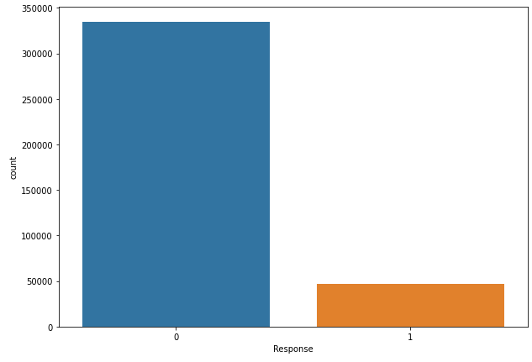
04
Exploratory Data Analysis - Before
There is a lot of imbalance in the target variable

Slide 13
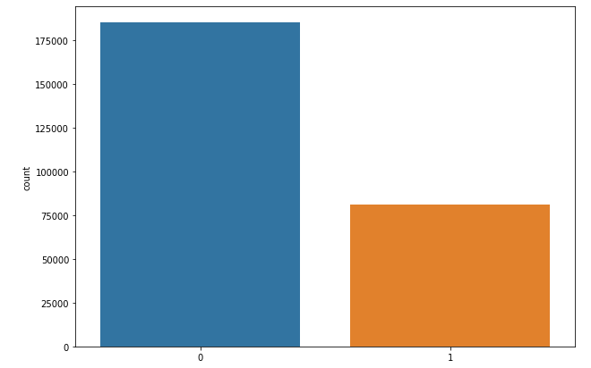
04
Exploratory Data Analysis - After
Oversampling and undersampling to balance the data

Slide 14
05
Data Pre-processing

Slide 15
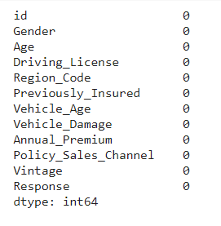
05
Data Pre-processing
There are No null values

Slide 16
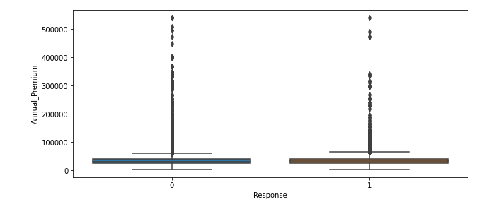
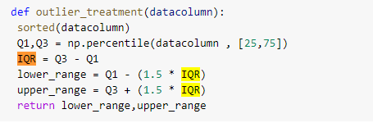
05
Data Pre-processing
Outlier Detection

Slide 17
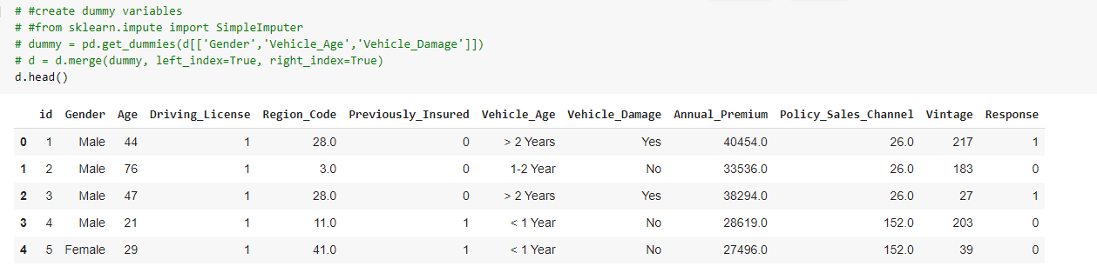
05
Data Pre-processing
Create dummy variables
Gender
Vehicle_Age
Vehicle_Damage

Slide 18
06
Exploratory Data Analysis

Slide 19
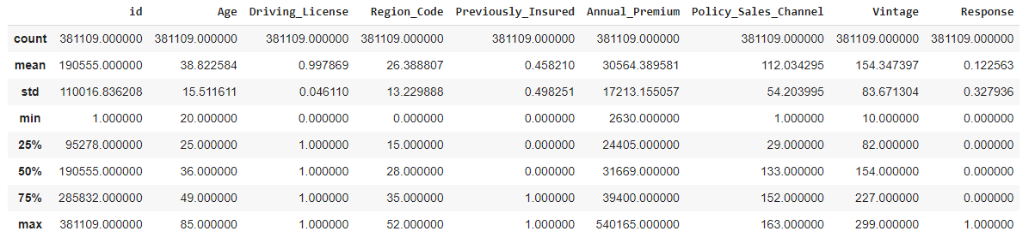
06
Exploratory Data Analysis

Slide 20
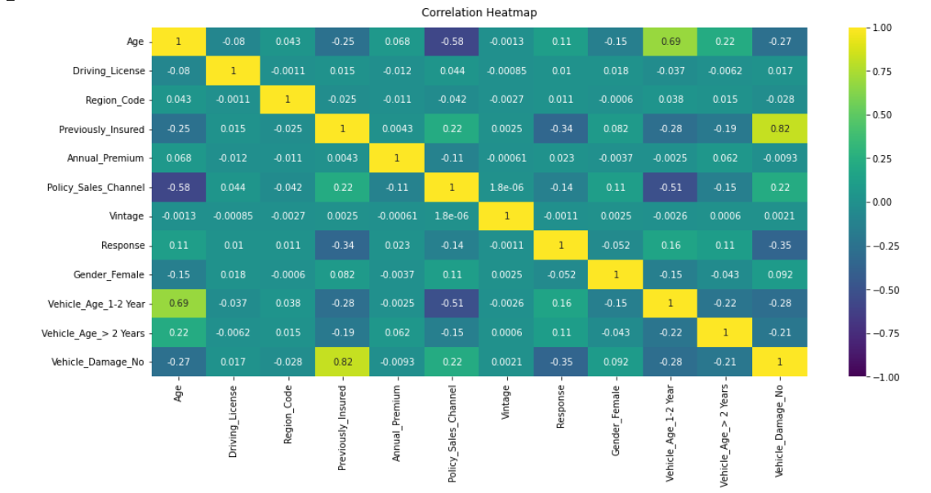
06
Exploratory Data Analysis - Before binning
All the variables have less significant correlations with the target variable
Vehicle_Damage_No, Previously_Insured have relatively strong negative correlation with target variable

Slide 21
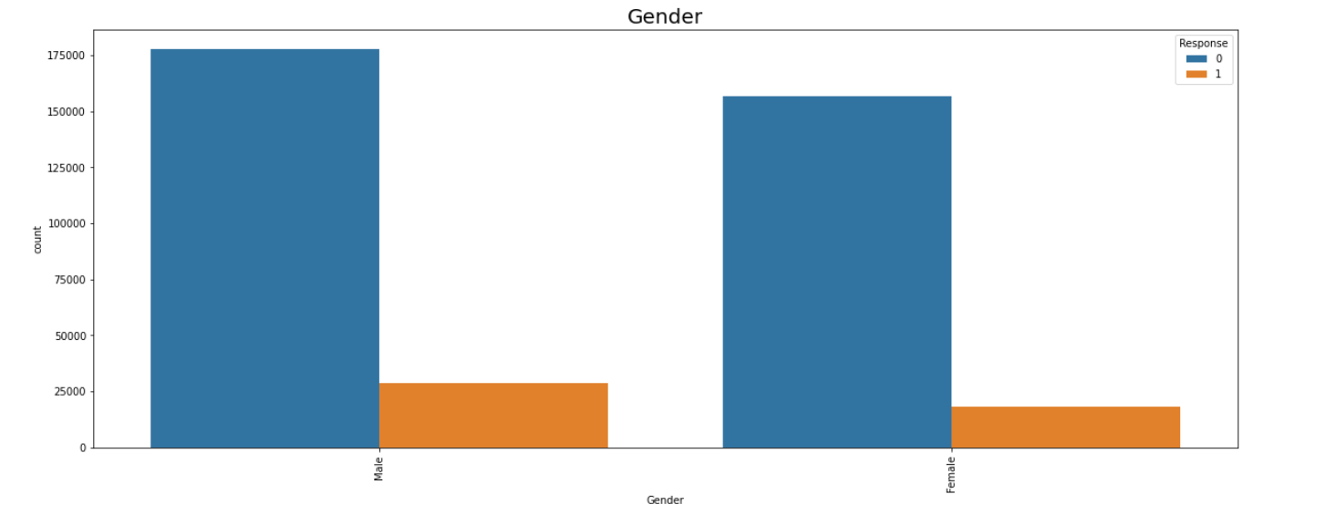
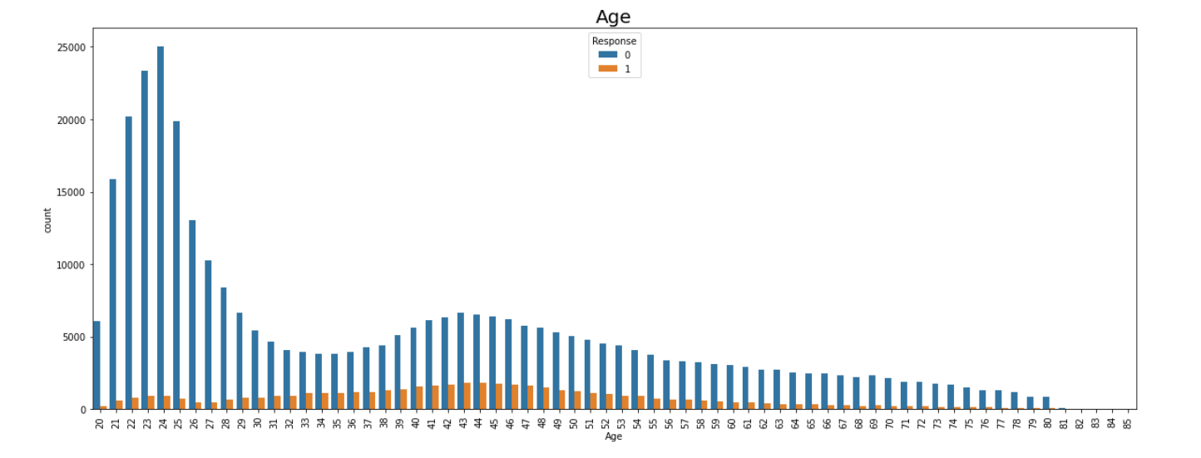
06
Exploratory Data Analysis
Relatively males are more likely to take auto insurance with 16.06% conversion rate when compared to females with 12% conversion rate
Users in between age groups 35-50 are more likely to take auto insurance with conversion rate of 50.67%

Slide 22
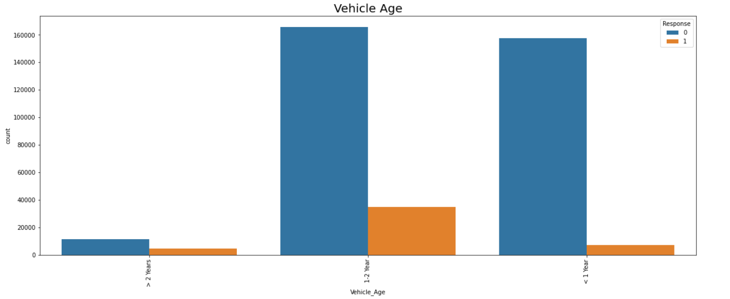
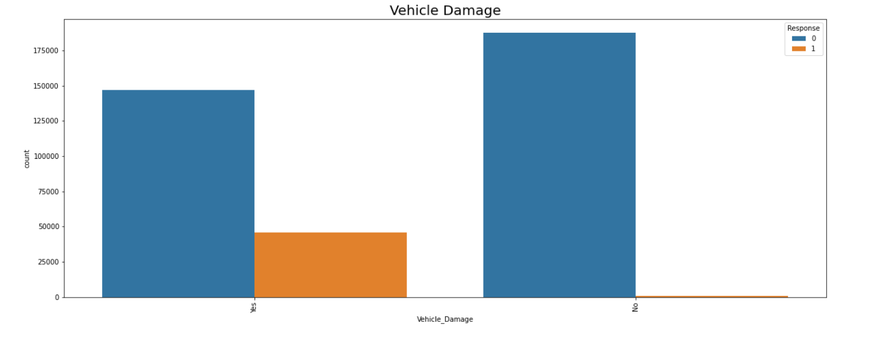
06
Exploratory Data Analysis
If the user has a vehicle age of more than 2 years, the conversion ratio is around 30%
If the user had previous damage, the conversion ratio is around 30%

Slide 23
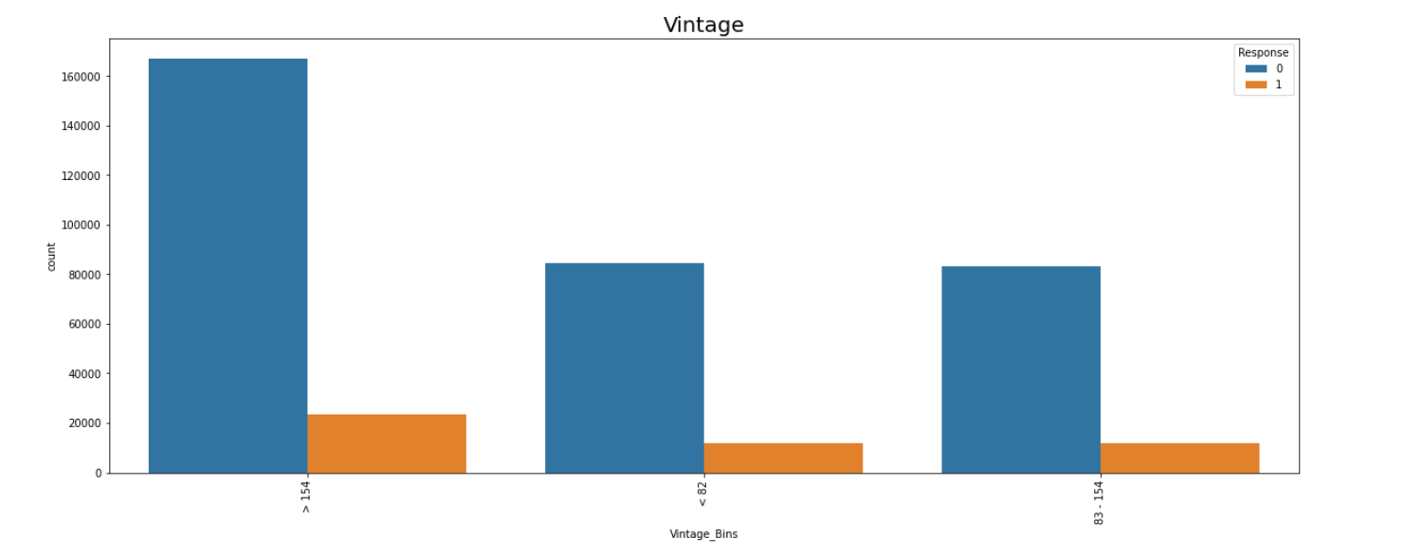
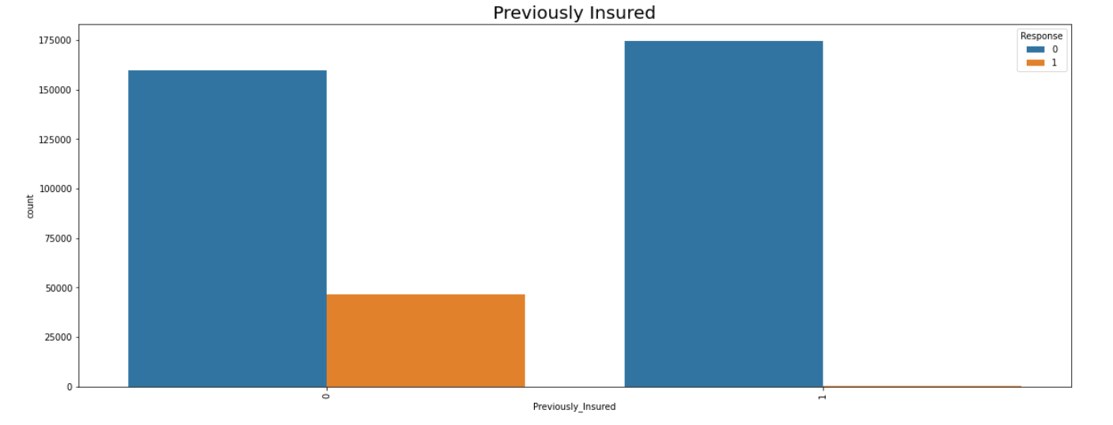
06
Exploratory Data Analysis
Customers associated with the company for 1-83 days are slightly more likely to opt for auto insurance with conversion rate of 14.02%
If the user had no previous insurance, the conversion ratio is around 30%

Slide 24
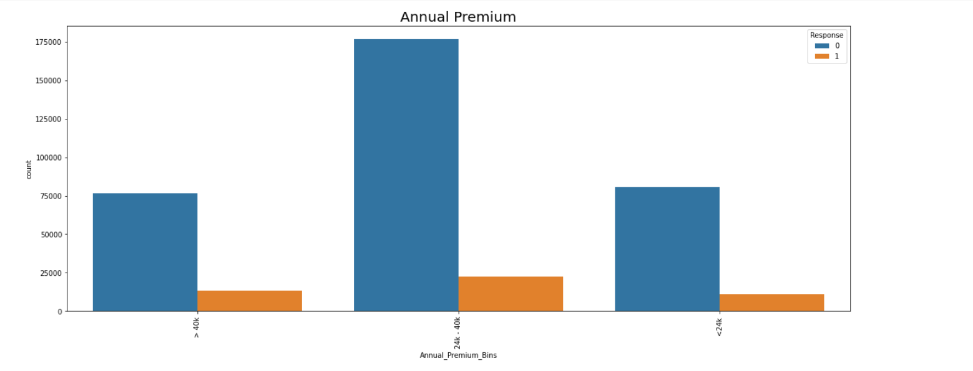
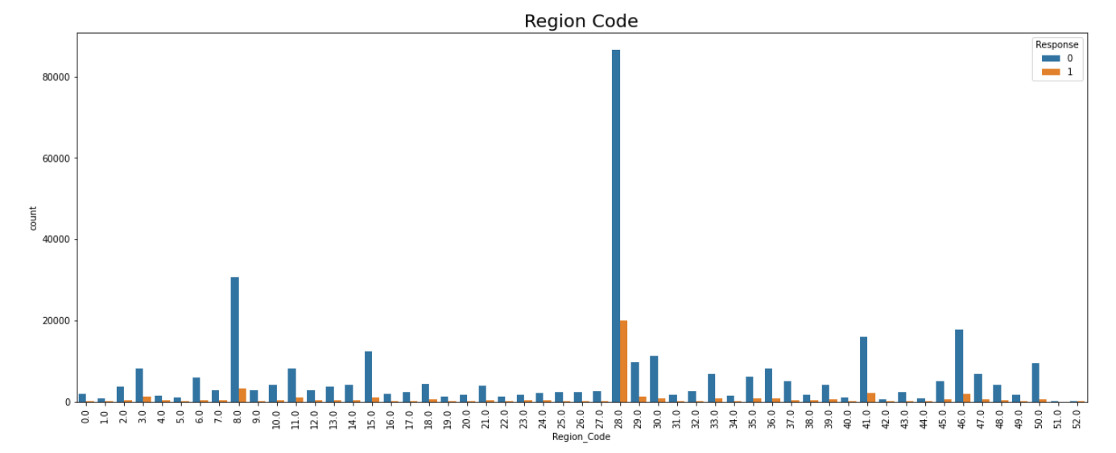
06
Exploratory Data Analysis
Region with code 28 has higher conversion ratio of 23.02%
Users with annual premium of over 40,000 have conversion ratio of 17.157%

Slide 25
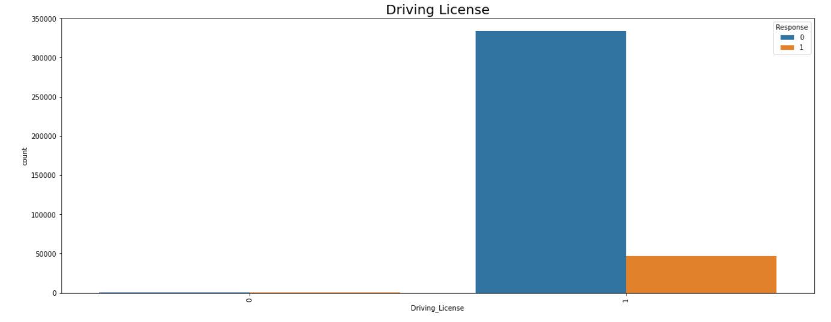
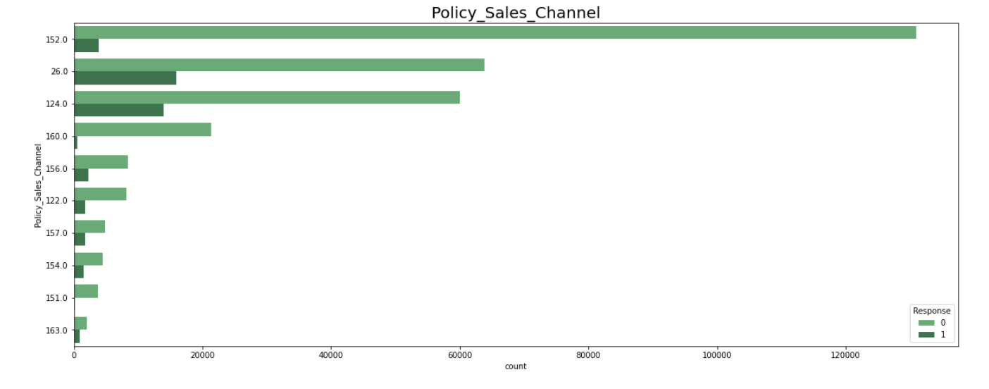
06
Exploratory Data Analysis
Users with driving license have a conversion ratio of 14%
Policy sales channel number 26 has a conversion ratio of 20%
Notes:
Talk about binning

Slide 26
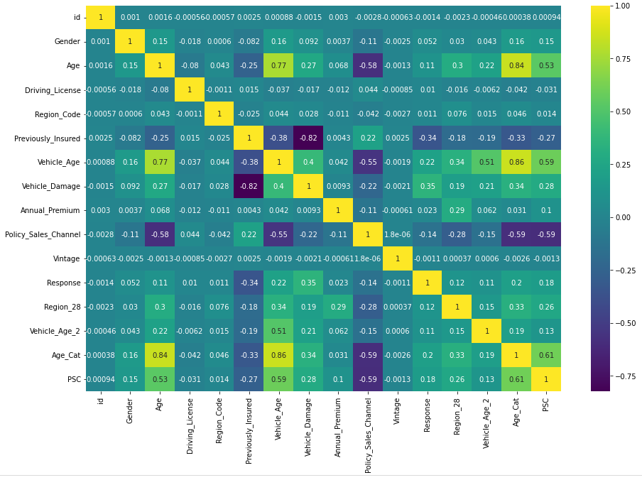
06
Exploratory Data Analysis- After binning
All the binned variables have relatively stronger correlations with the target variable after binning
X Features: 'Previously_Insured', 'Vehicle_Age_2', 'Age_Cat', 'Vehicle_Damage', 'Annual_Premium', 'Vintage', 'PSC', 'Region_28'

Slide 27
07
Modeling

Slide 28
07
Precision and Recall
Precision: Out of all the times the model predicted a response of 1, how many times were they actually 1?
TP / (TP + FP)
Recall: Out of all the responses of 1 in the dataset how many times did the model predict correctly?
TP / (TP + FN)
Low precision means we have a lot of false positives
Targeting the wrong people with sales and marketing
Low recall means we have a lot of false negatives
Inability to identify key targets for sales and marketing

Slide 29
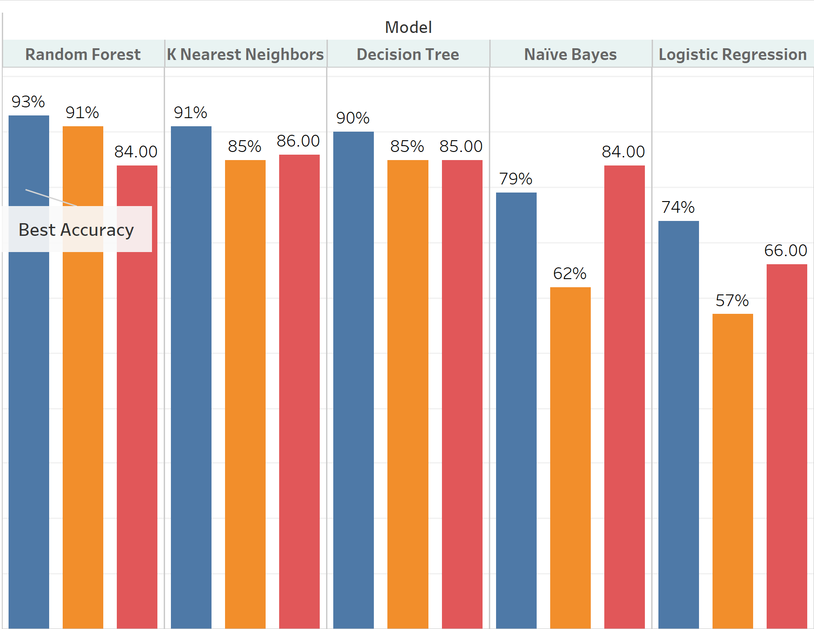
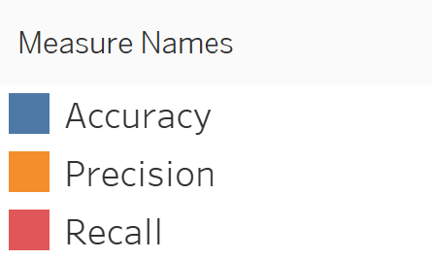
07
Data Modeling

Slide 30
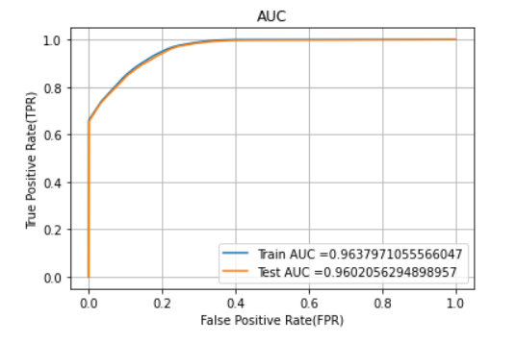
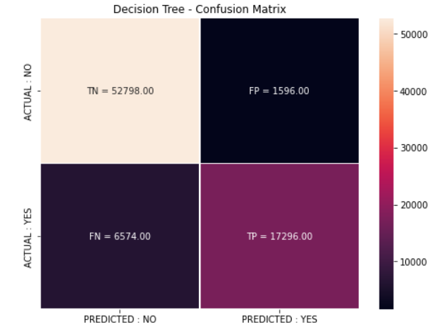
07
Data Modeling - Best Performing Model
ROC Curve
Confusion matrix

Slide 31
08
Findings

Slide 32
08
Findings
We are recommending a decision tree model
Accurate predictions
Underlying framework is transparent and explainable
EDA and Modeling work has uncovered that…
There is a need to evaluate costs associated with Policy Sales Channel 152 and 26
Customers with existing Auto Insurance Policy are not interested in a replacement policy
Customers with vehicle damage history are more likely to purchase a policy

Slide 33
09
Business Recommendations

Slide 34
09
Business Recommendations
Integrate cross-sell predictions into existing business processes
Model deployment framework will vary based on new vs existing business
Existing Health Insurance Policyholders
New Health Insurance Policyholders
Batch Deployment
Real-Time Deployment

Slide 35

09
Use Case 1: Call Routing
Incoming calls from existing customers can be handled based on cross-sell prediction
Requires predictions to be generated ahead of time (batch deployment)
Incoming customer service call
Cross-Sell Prediction = 1
Cross-Sell Prediction = 0
Efficient customer service rep trained in initiating cross-sell
Customer service rep more focused on solving customer’s query and less on selling auto product
Call Transferred to Sales
Call placed at front of sales queue
Call Transferred to Sales (Highly Unlikely)
Experienced and efficient sales rep
High performing sales rep

Slide 36

09
Use Case 2: Marketing
The marketing team can target existing health insurance policyholders based on cross-sell prediction
Requires predictions to be generated ahead of time (batch deployment)
Send flyers, emails, and other advertisements for auto insurance product to policyholders predicted to purchase an auto policy
Assess current marketing strategies. Are we wasting money marketing to people with a low probability of purchasing an auto policy?

Slide 37

09
The Possibilities are Endless!
We are just scratching the surface of how the cross-sell model could be deployed to drive business results
To name a couple more potential use cases...
Real-time application to incoming new health insurance business
Tailor the digital experience
Leverage third-party data to streamline process flow
Website layout and design
Type and frequency of advertisements

Slide 38
THANK YOU

